Slide 1
The Brewster Ponds Coalition Annual Meeting
Conducting Research with The Citizen Scientists Program:
Cyanobacterial Population Dynamics and Cyanotoxins
Nancy Leland, M.S. Lim-Tex

Slide 2
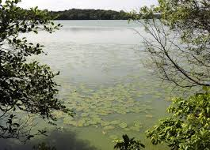
Why are we doing this?
The plankton: Population ecology within a shared space…
with populations that just happen to produce toxins

Slide 3
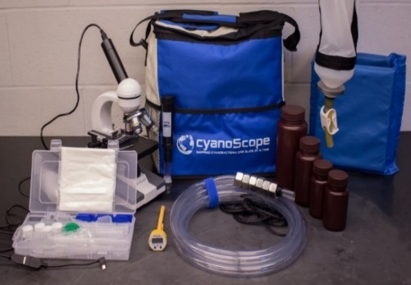
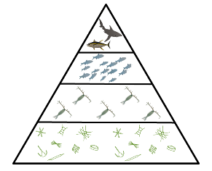
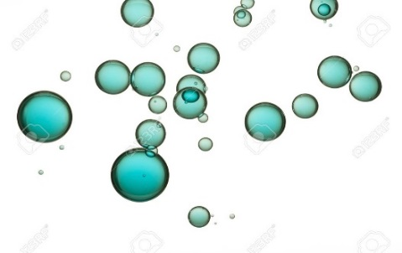
UNH-Center for Freshwater Biology and Ecotoxicology
Predict blooms
Estimate toxin levels
Food webs
Aerosols

Slide 4
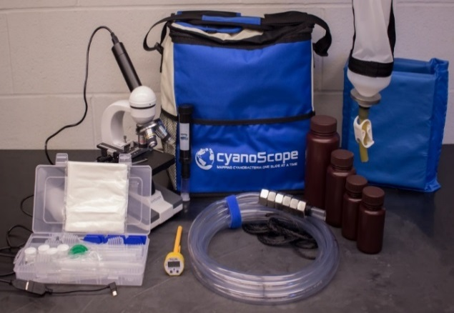
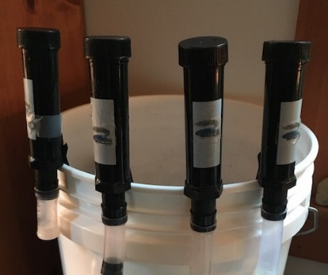
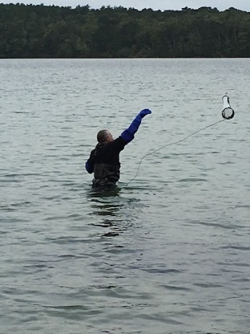
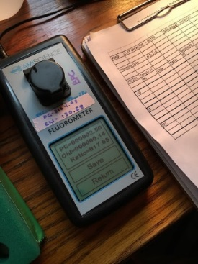
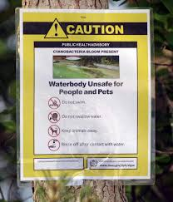
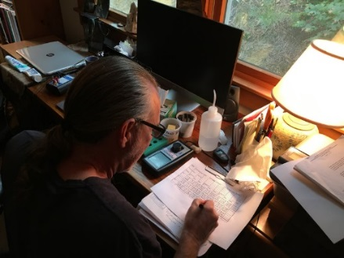
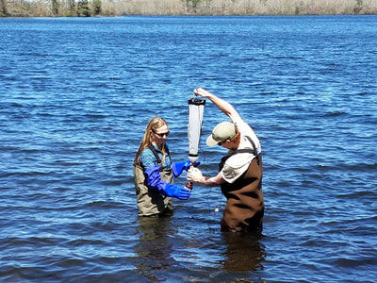
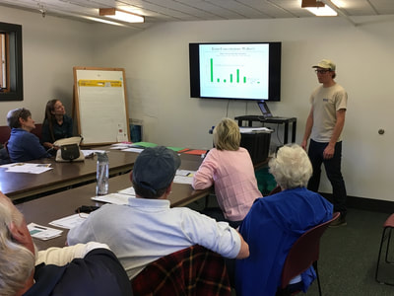
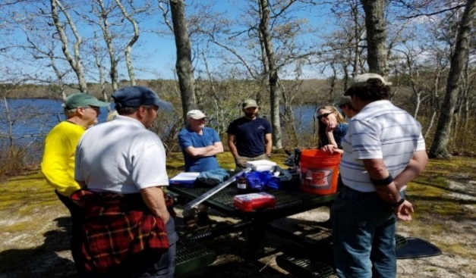
Research supports the program
Your high quality data
Timely, informed decisions

Slide 5
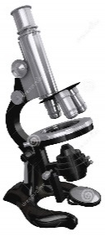
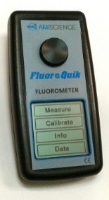
Predict blooms
Estimate toxin levels
Samples representing populations within ecological niches
<50 µm, WLW and BFC

Slide 6
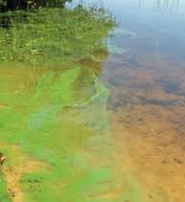
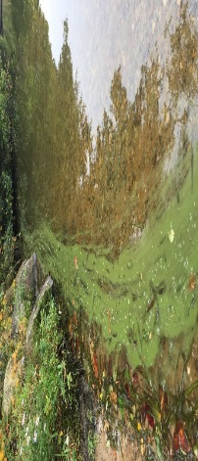
BFC’s preceed WLW for growth and microcystin production
Growth rate is a dynamic metric

Slide 7
Food webs
Alosa YOY diets:
Cyclopoid copepods
Large cladocerans

Slide 8
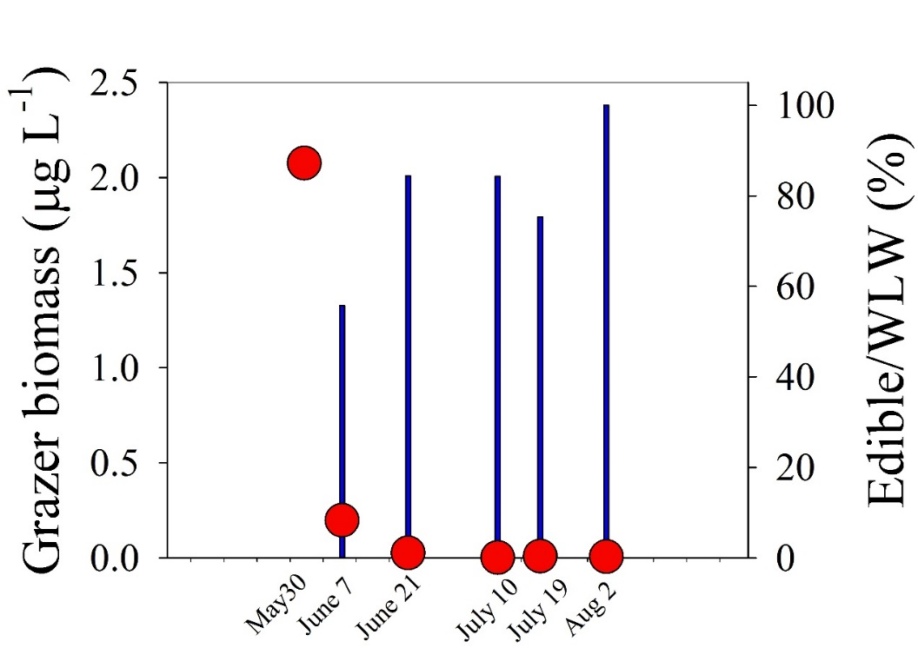
Samples which represent cyanotoxin transport mechanisms
Edible cyanobacteria = <50 µms
“Grazers”
Aerosols
Fine (<2 µm)
Omnivores
Coarse (20 µm)

Slide 9
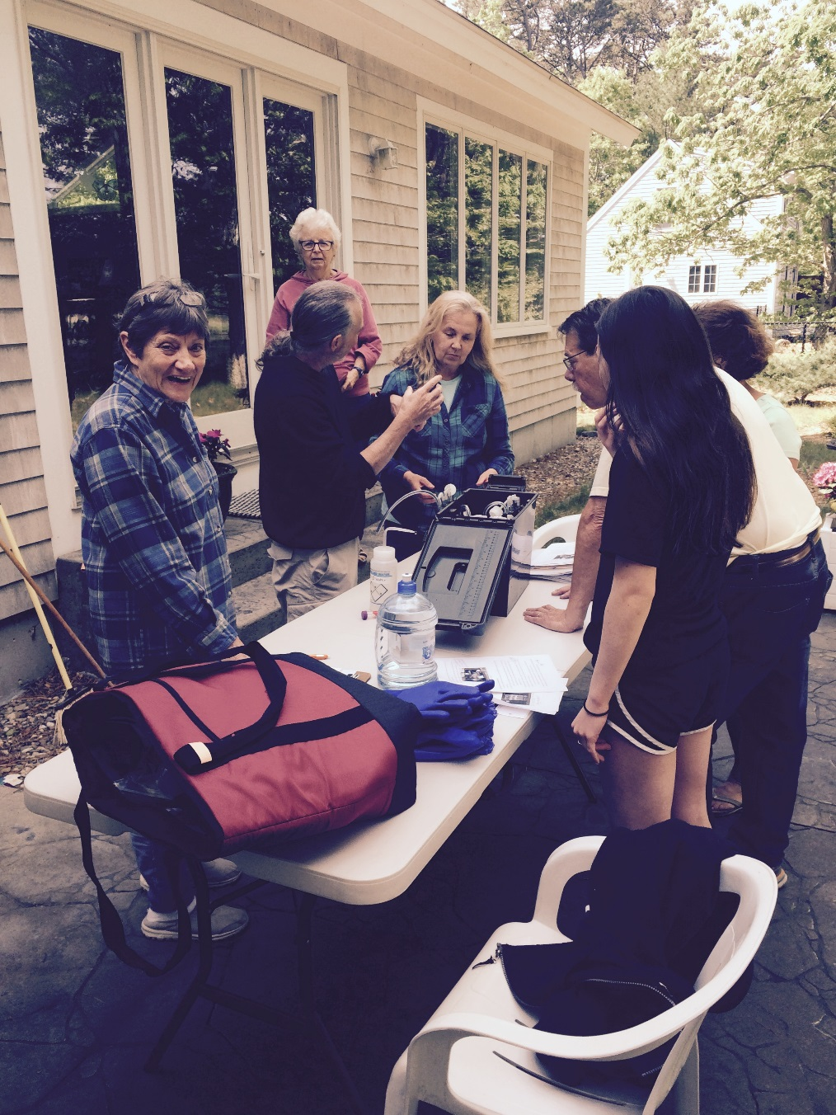
Hailey and her Amazing Aerosol Collectors !!
Thank you for your:
Enthusiastic support
Tough questions
We get new ideas!

